Slide 1
Personalized Home Automation System using Mobile Phones
Project Name

Slide 2
Project Team
Mentor: Prof. Ashwni Kumar
Team Members:
Srishti chaudhary
simran rathi
himani gandhi

Slide 3
Abstract View of the Project
This project is mainly focused and concerned with the designing of a Smartboard based system that allows the users upon authentication to remotely control, monitor and manage the home appliances through a mobile-phone based interface like an Android Application.

Slide 4
Why Home Automation System ?
Adds Safety Through Appliance and Lighting Control
Increases Convenience Through Temperature Adjustment
Saves Time
Saves Money and Increases Convenience

Slide 5
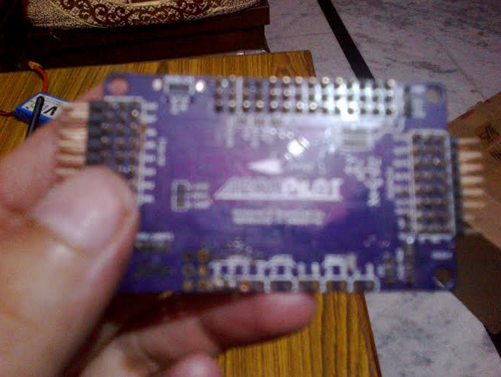
Devices Used
Microcontroller 89S51:
The microcontroller used is the brain of the entire system. It will receive the commands executed on the 8870 IC and compute the appropriate instructions to control the home appliances

Slide 6
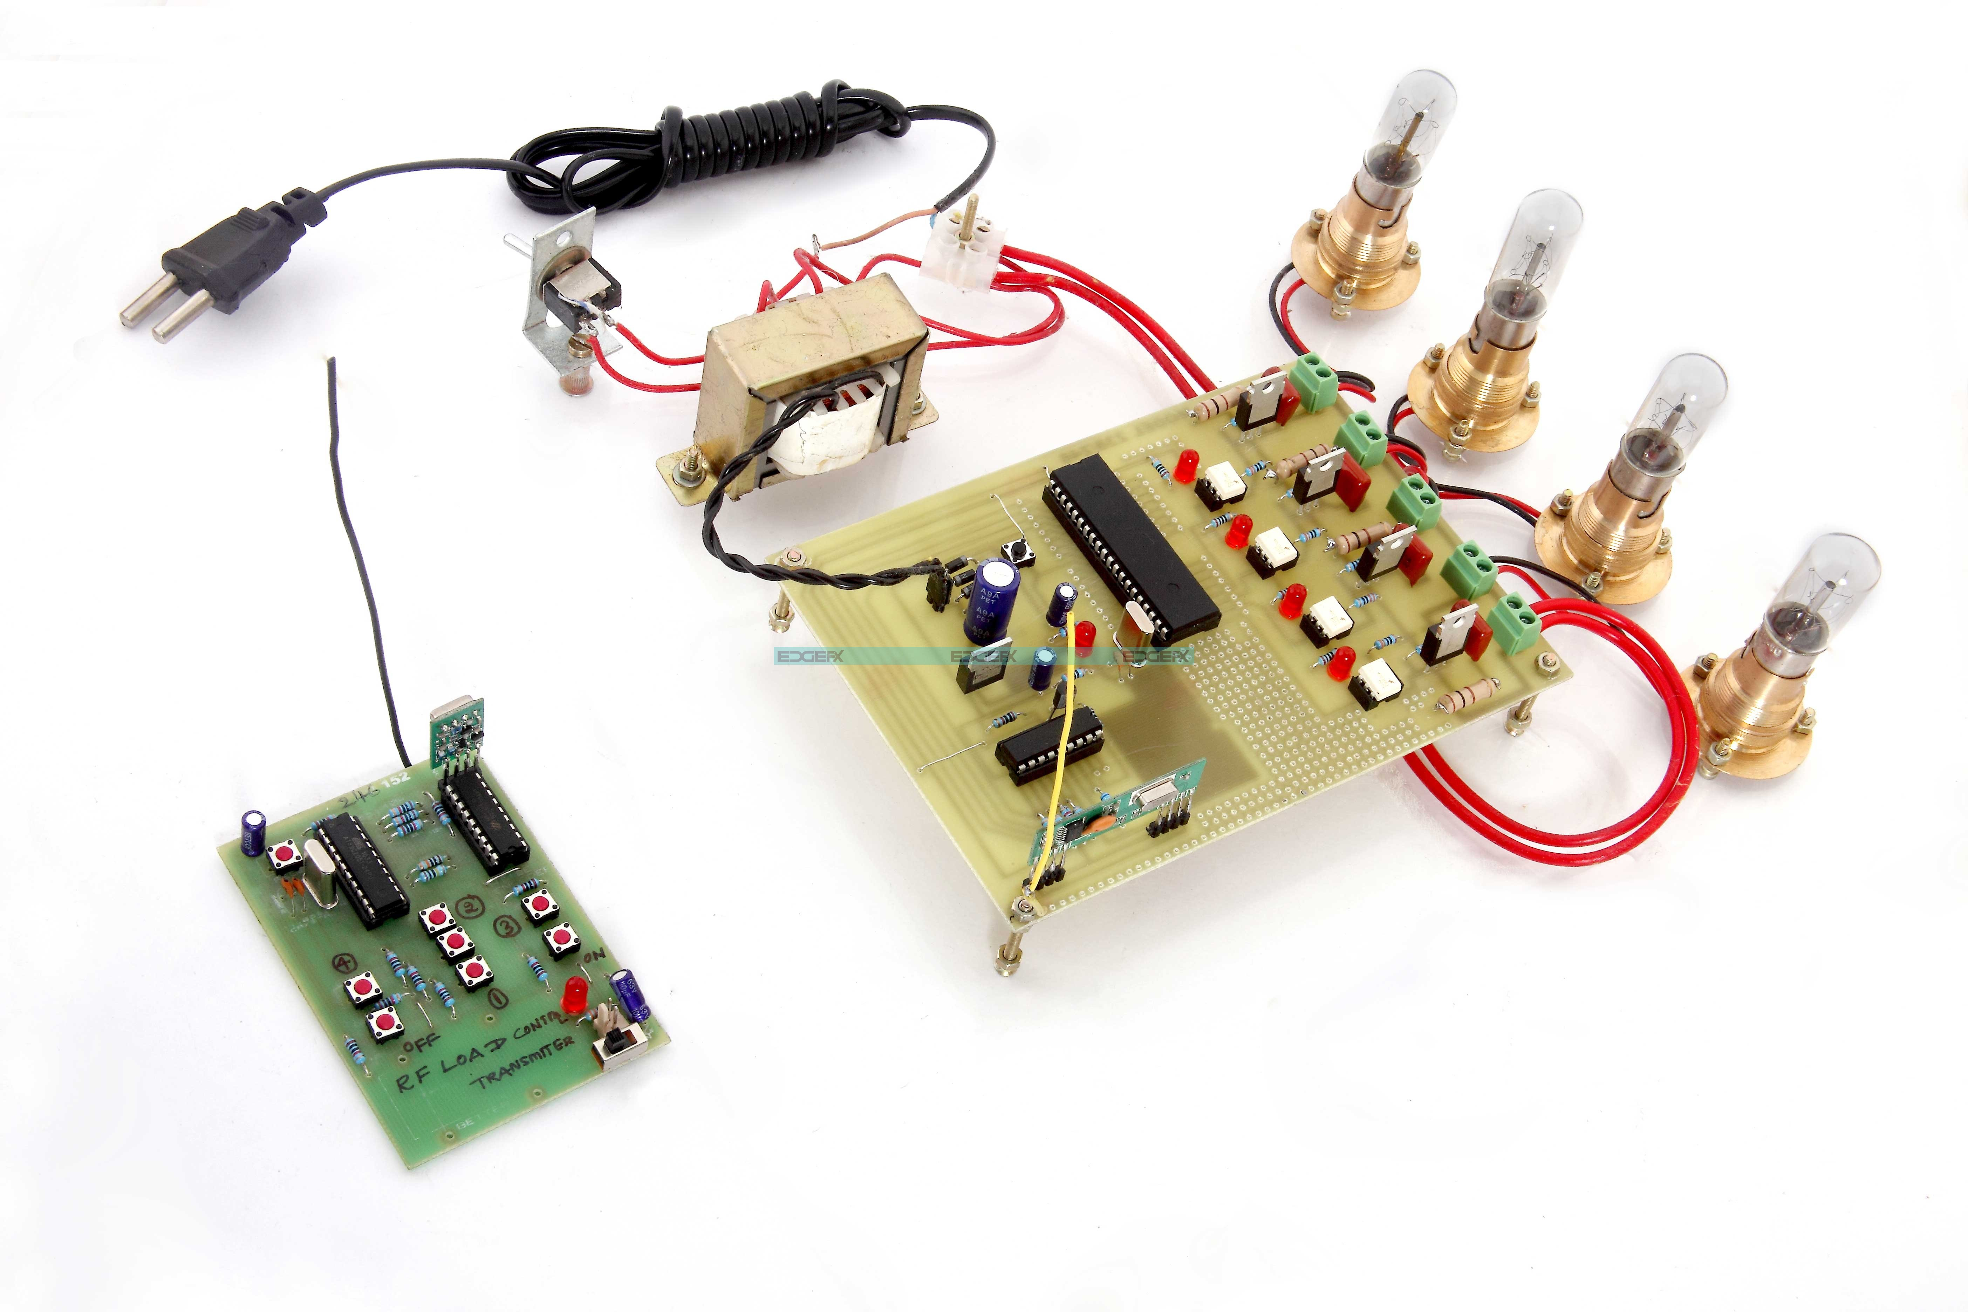
Driver circuit : Driver circuit is nothing but a switching circuit, which provides actual connection between our circuits to the appliances.

Slide 7
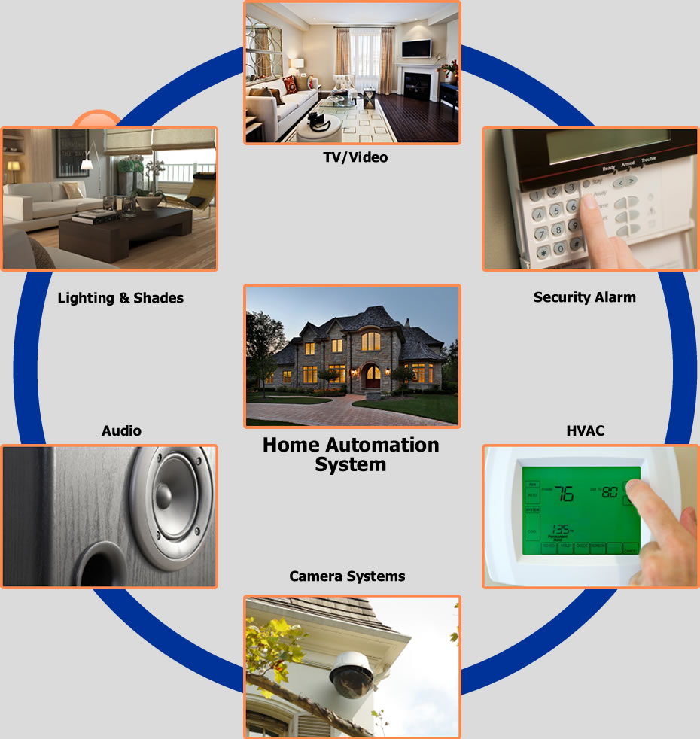
Home Appliance: The home appliances must be connected to the main power supply at all times. This is a precondition for the system.

Slide 8
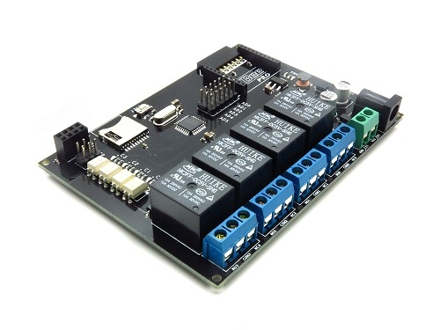
Relays :
A relay is an electrically operated switch.
Many relays use an electromagnet to operate
a switching mechanism mechanically,
but other operating principles are also used.
Relays are used where it is necessary to control
a circuit by a low-power signal (with complete
electrical isolation between control and controlled
circuits), or where several circuits must be
controlled by one signal. Relays were used extensively
in telephone exchanges and early computers to
perform logical operations, but now is used
in home automation and robot control.

Slide 9
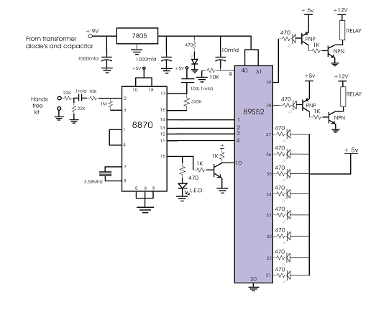
Block Diagram

Slide 10
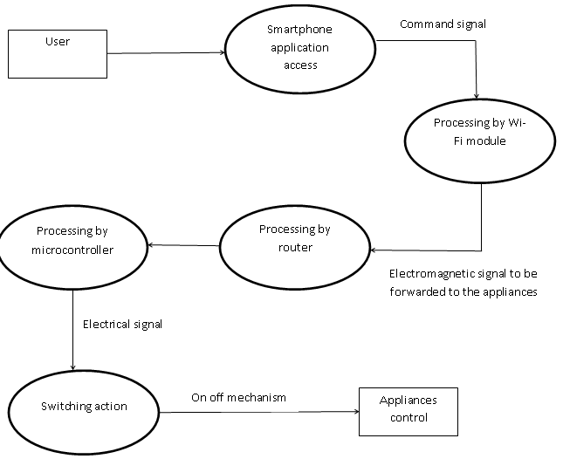
Data Flow Diagram
IC 8870
BCD o/p

Slide 11
Connectivity
The Smartboard which is an intelligent Switchboard will communicate with our mobiles and tablets and this Smartboard has the ability to control and manage the electrical appliances through an interface.

Slide 12
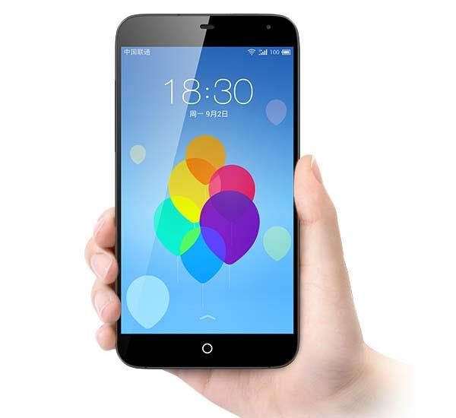
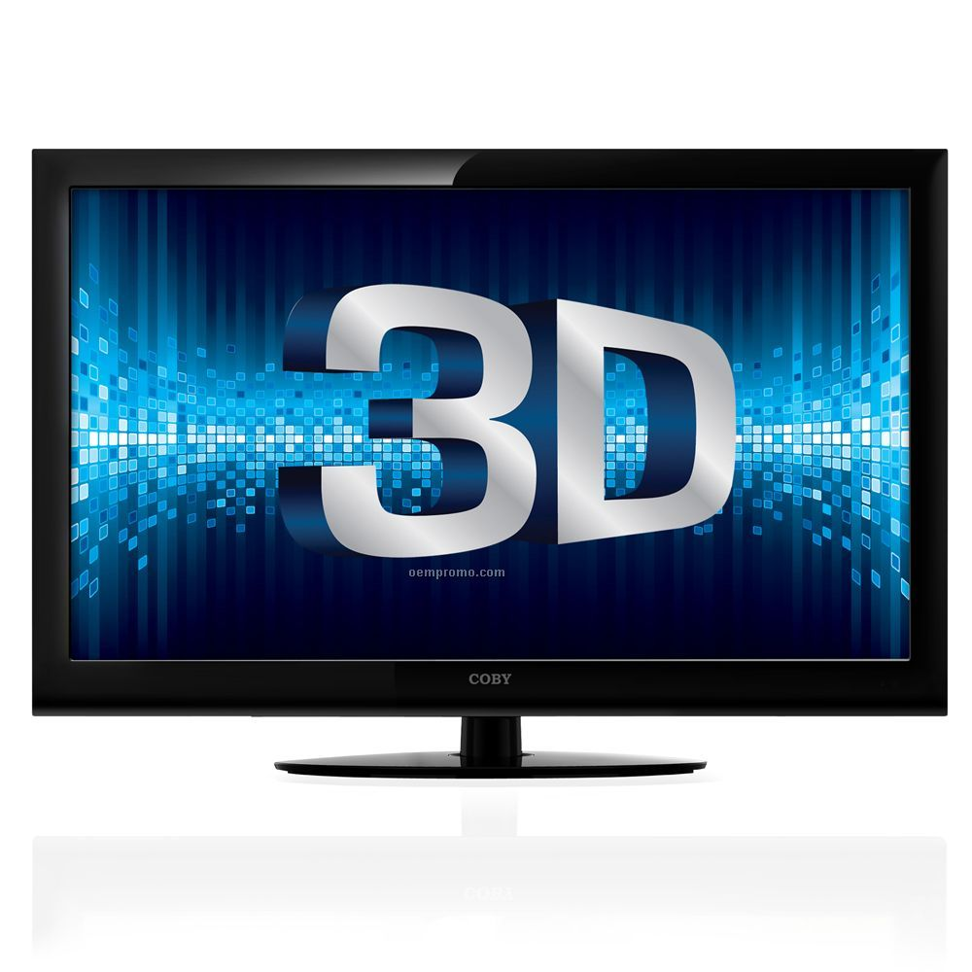
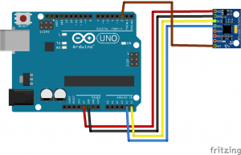
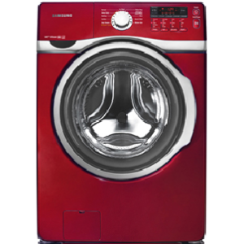
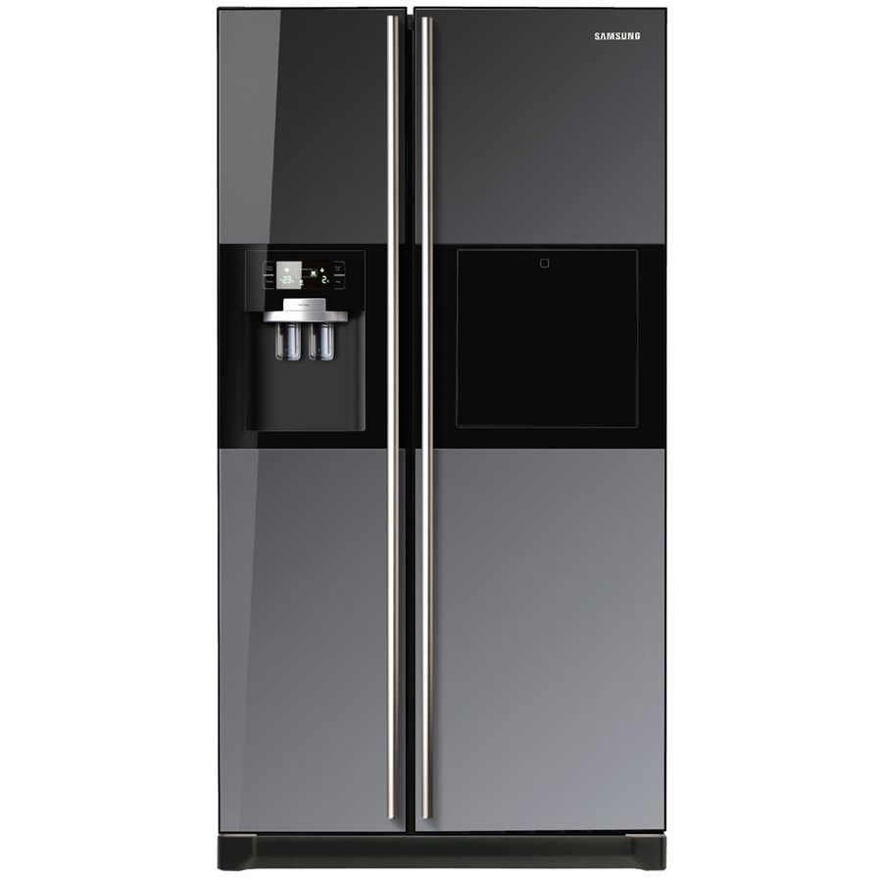
Hypothetical Representation of
Working of Project
LED
SmartPhone
Washing
Machine
F
R
I
D
G
E
SmartBoard

Slide 13
Innovativeness & Usefulness
Hassle free integration into all households due to its unique modular design.
Complete isolation of voltages ensures User-safety.
Internet connectivity makes the user monitor operate from anywhere in the world.
Easy setup makes it easy to use
The web-portal setup for hotels,warehouses and universities makes monitoring power consumption an ease.

Slide 14
Competitive Advantage & Market Potential
Intelligent lighting that is popular with hotel owners will save lots of electricity and add an extra element of luxury by the smartboard.
Warehouses would also benefit with the ease of control and would save electricity at the same time.
Dual mode inputs both TV Remote and Bluetooth/Android App makes it easy to control with our mobile that is always close to us.
Due to its simplistic design,its installation can be done easily by anyone.

Slide 15
Future Scope The project can be further extended to operate via Bluetooth connectivity and the number of appliances can further be extended to more than one. Why prefer Bluetooth?? It is preferable to use Bluetooth because nowadays people have their smart phones with them all the time, since the smart phones have Bluetooth facility in them, thus it's better to use Bluetooth rather than using RF remotes or IR remotes.

Slide 16
Benefits of Bluetooth connected Home Automation System
Using Bluetooth has many of its own advantages:
1. It's secure.
2. Easy to use.
3. It works in short distance range (i.e. up to 10mtrs.)
4. Anyone can find free Bluetooth apps on android and many more.

Slide 17
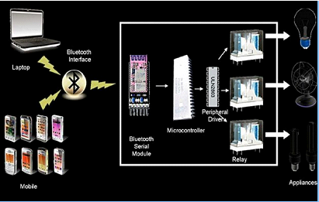

Slide 18
Research & References
https://en.wikipedia.org/wiki/Internet_of_Things
http://whatis.techtarget.com/definition/Internet-of-Things
http://www.microchip.com/pagehandler/en-us/technology/wifi/home.html
https://en.wikipedia.org/wiki/Wi-Fi#Hardware

